Slide 1


Green Pace
Security Policy Presentation
Developer: Bob Johnson
CS-405: Secure Coding

Slide 2

OVERVIEW: DEFENSE IN DEPTH
DiD, or defense in depth, which is security using a multi-layer defense system.

Slide 3
THREATS MATRIX
Likely Standards that have an elevated relevance | Priority Standards with high relevance
Low priority Standards with low relevance | Unlikely Standards with slightly elevated relevance

Slide 4
10 PRINCIPLES
Validate Input Data
Heed Compiler Warnings
Architect and Design for Security Policies
Keep It Simple
Default Deny
Adhere to the Principle of Least Privilege
Sanitize Data Sent to Other Systems
Practice Defense in Depth
Use Effective Quality Assurance Techniques
Adopt a Secure Coding Standard

Slide 5
CODING STANDARDS
INT-30-C: Ensure unsigned integer operations do not wrap.
DCL-52-CPP: Never qualify a reference type with const or volatile.
STR-53-CPP: Range check element access.
STR-02-C: Sanitize data passed to complex subsystems.
MEM-50-CPP: Do not access freed memory.
MSC-11-C: Incorporate diagnostic tests using assertions.
ERR-55-CPP: implementation-defined termination of the program.
MEM-53-CPP: Explicitly construct and destruct objects when manually managing object lifetime.
OOP-54-CPP: Gracefully handle self-copy assignment.
CON-50-CPP: Do not destroy a mutex while it is locked.
Rule | Severity | Likelihood | Remediation Cost | Priority | Level
STD-001-CPP | High | Unlikely | Medium | High | 2
INT-30-C | High | Probable | High | P6 | L2
DCL-52-CPP | Low | Unlikely | Low | P3 | L3
STR-53-CPP | High | Unlikely | Medium | P6 | L2
STR-02-C | High | Likely | Medium | P18 | L1
MEM-50-C | High | Likely | Medium | P18 | L1
MSC-11-C | Low | Unlikely | High | P1 | L3
ERR-55-CPP | Low | Likely | Low | P9 | L2
MEM-53-CPP | High | Likely | Medium | P18 | L1
OOP-54-CPP | Low | Probable | High | P2 | L3
CON-50-CPP | Medium | Probable | High | P4 | L3

Slide 6
ENCRYPTION POLICIES
Flight - Encryption in flight is the act of using secure channels to send data. This is done by the use of TSL or SFTP. This should always be used to help prevent unauthorized access and to prevent leaks.
At Rest - Encryption in rest protects data that is stored in formats like a database or in devices like phones and computers. There are options like AxCrypt for use. Encryption in rest is important to keep data from being stolen or accessed by unauthorized individuals.
In Use - Encryption in use is the practice of encrypting memory even while it is use. This helps prevent crashes that result in memory dumps. Bitlocker is an example that encrypts and requires the use of a key. This practice should also be used when data is being accessed/used.

Slide 7
TRIPLE-A POLICIES
Authentication – Authentication verifies a user says they really are who they are and that they should be allowed access to information. This is done by the use of tools like passwords, certificates, etc. and helps prevent the loss or theft of data.
Authorization - Authorization works with authentication and verifies that a user should be allowed access to data/information/files. This prevents unauthorized users gaining access to privileged information.
Accounting - Accounting is the process of recording and keeping track of who access what information when and how. Information is stored like account numbers, usernames, passwords and dates and times of when a particular piece of information was accessed or used. If a breach or leak occurs, this provides information of where, when and who did it.

Slide 8
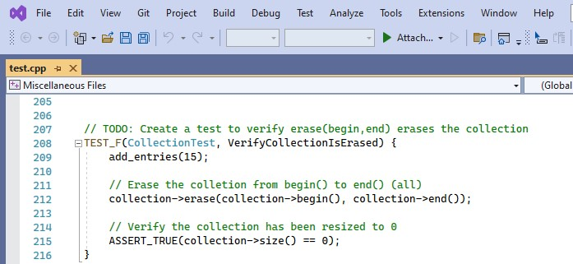
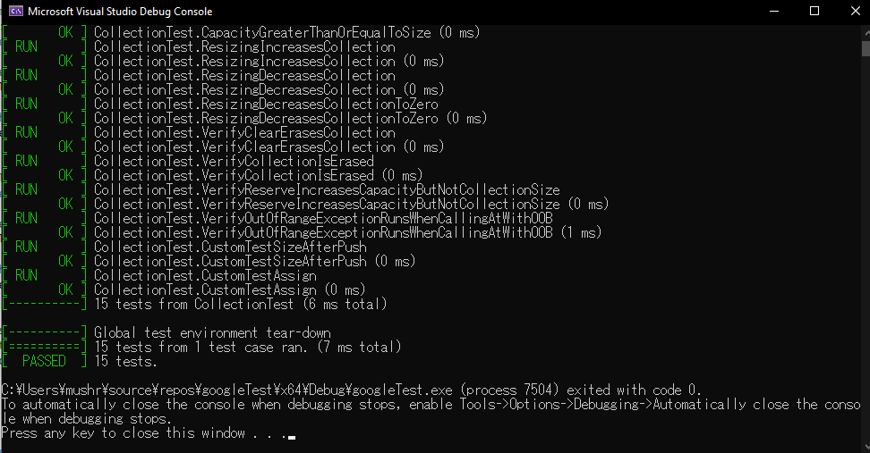
has the collection been erased?

Slide 9
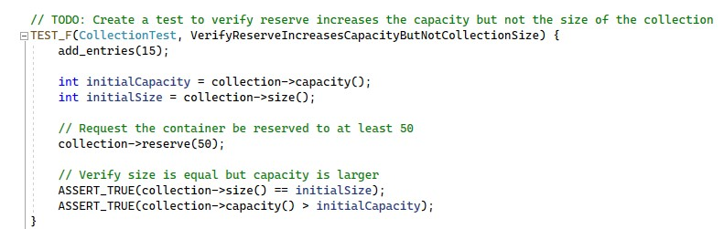
Is the reserve, and not size, increased?

Slide 10
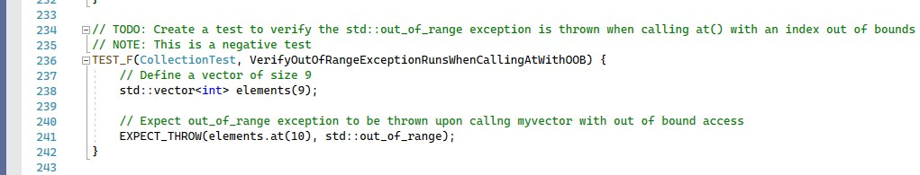
Is out of range exception thrown?

Slide 11
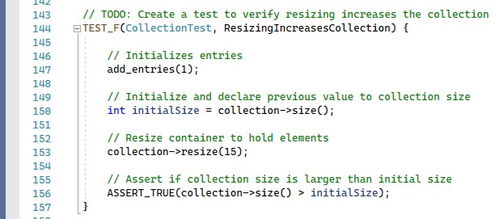
Does resizing increase the collection?

Slide 12

AUTOMATION SUMMARY

Slide 13
TOOLS
DevSecOps pipeline - DevSecOps is integrating security into your software development life cycle. The software development life cycle is the cycle from the creation of code to its testing to its push into the main branch
Tools – External tools such as cppchecker and IDEs testing are used to discover warnings, errors, and messages when developed code is being executed. Below is an example of the cppchecker tool warnings and messages.

Slide 14
RISKS AND BENEFITS
Now
Risks – Deadlines may get pushed back due to tests being run on sections of code prior to the sections being pushed onto the main project.
Benefits – The project is more secure, the project’s code is developed with the consideration of security policies and practices, and security problems can be discovered and fixed during the development phase cycle.
Wait
Risks – Code may not be compatible with security features, unsecure code exists throughout the development cycle, costs may go overbudget due to finding and reworking code, project may go past expected due date.
Benefits – The initial development phase can be progressed and completed sooner while deadlines can be kept.

Slide 15
RECOMMENDATIONS
Security implemented during the software development lifecycle.
Implementing and following a security plan.
AAA
encryption

Slide 16
CONCLUSIONS
Security standards are necessary and should be made to keep businesses, people and sensitive information safe to prevent unauthorized individuals from gaining access. Practices utilizing Defense in Depth and AAA can help prevent access to and loss from a system invasion. Implementing several layers of defense can ensure that data will be safe despite a layer being breached. Authentication, authorization and accounting prevent access to persons not authorized to information by requiring things like usernames and passwords. Accounting can ensure that when information is accessed, who, what, when and how information is used can logged and reviewable when that information is deemed necessary to review. Developers can also contribute to the security of software and data by following industry best practices to make sure the code that is written is as free of security vulnerabilities as possible. While security can not be 100% guaranteed, following these practices allows the software and data involved to be as secure as possible and prevent leaks of information in the case of an intrusion.

Slide 17
REFERENCES
Fortinet. (2022). What is Defense in Depth? Defined and Explained. Fortinet.
https://www.fortinet.com/resources/cyberglossary/defense-in-depth
SEI CERT C++ Coding Standard - SEI CERT C++ Coding Standard - Confluence. (n.d.). Wiki.sei.cmu.edu. https://wiki.sei.cmu.edu/confluence/pages/viewpage.action?pageId=88046682
Top 10 Secure Coding Practices - CERT Secure Coding - Confluence. (n.d.). Wiki.sei.cmu.edu. https://wiki.sei.cmu.edu/confluence/display/seccode/Top+10+Secure+Coding+Practices?focusedCommentId=88044413
Mylonas, L. (2018, November 27). AAA Security: An Introduction to Authentication, Authorisation and Accounting.
Codebots.https://codebots.com/application-security/aaa-security-an-introduction-to-authentication-authorisation-accounting
The Basics of Web Application Security. (n.d.). Martinfowler.com. https://martinfowler.com/articles/web-security-basics.html

